Slide 1

Telemetry it is as easy as 123
Dutch Dynamics Community

Slide 2
Mededelingen
Telemetry it is as easy as 123
Graag microfoons op mute zetten
Vragen stellen in het midden en achteraf
Doormiddel van handje

Slide 3










Application Insights
introductie
Instellen
Agenda
Agenda
KQL
Performance toolkit
Tools
Vragen
afsluiter
Waarom?

Slide 4

Introductie
Telemetry it is as easy as 123
38 jaar
Getrouwd en 3 kinderen
2007 begonnen met Dynamics NAV gewerkt bij CTB en Mprise
2013 gestart bij 4PS en 2017 als productmanager
verantwoordelijk voor Business Central platform
4PS levert Business Central als Embed App uit aan de Bouw, Installatie en GWW markt
Nationaal en internationaal
Vestigingen in Ede, UK en België
Partners over de hele wereld

Slide 5
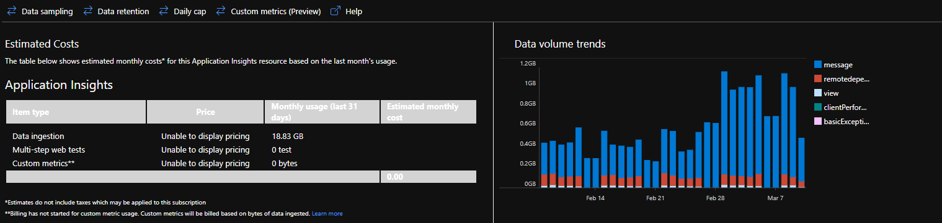
Wat is Application insights?
Telemetry it is as easy as 123
Onderdeel van Azure Monitor
Bekijken van telemetry vanuit meerdere applicaties
Kosten:
Standaard retention is 90 dagen daarboven extra kosten (0,085 per GB per maand)
1,940 per GB
Of ga naar “Usage and estimated costs” in App Insights.

Slide 6
Waarom monitoren?
Telemetry it is as easy as 123
Performance issues (Deadlocks, Long Running Query's)
Wordt bepaalde functionaliteit gebruikt en hoe vaak?
Welke pages worden het meest bezocht en via welke wegen?
Welk onderdeel geeft de meeste errors?
Maar let op prioriteer!

Slide 7
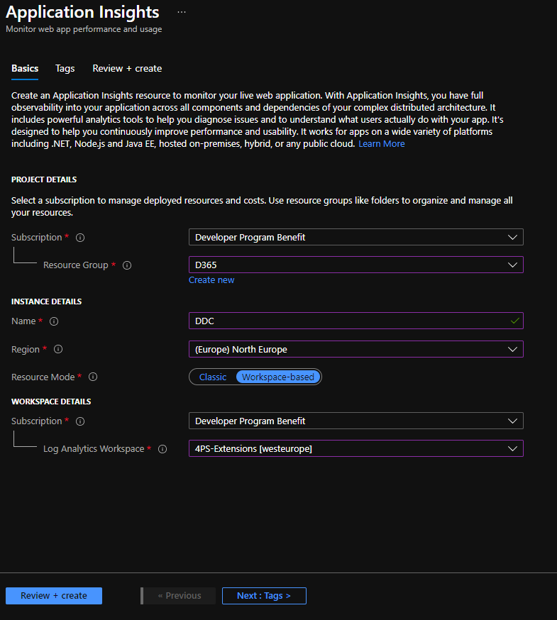
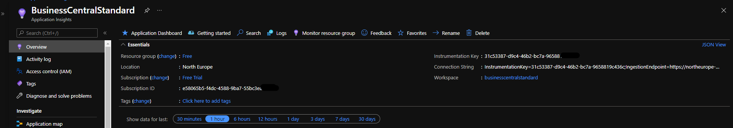
Hoe in te stellen?
Telemetry it is as easy as 123
Ga naar portal.azure.com -> Application insights
Kopieer de “instrumentation key”

Slide 8
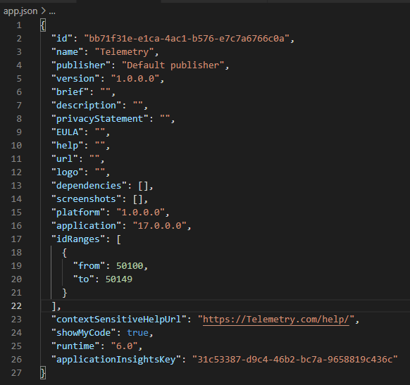
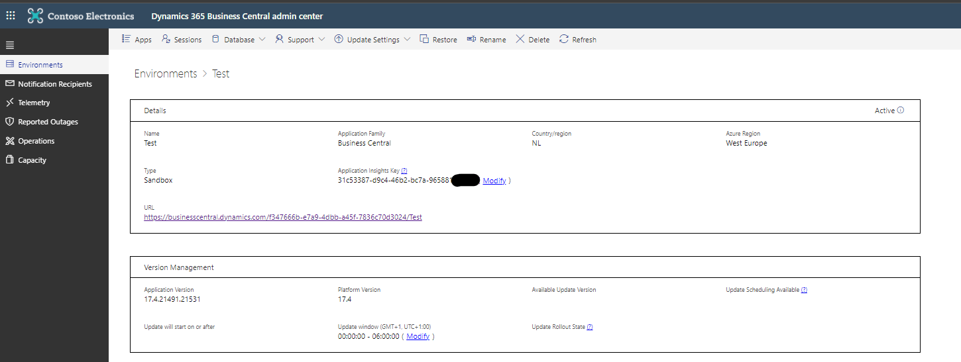
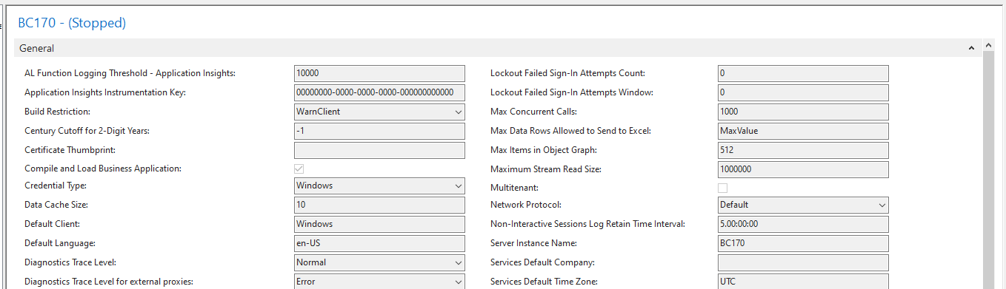
Hoe in te stellen?
Telemetry it is as easy as 123
MS SaaS
On-premise
Extension
Notes:
- Let erop dat NST’s moeten herstart worden

Slide 9
Signalen 1
Telemetry it is as easy as 123
Area | Omschrijving | Online | On-premise | Extension support
App key vault secrets | Provides information about the retrieval of secrets from Azure Key Vaults by extensions. | Ja | Ja | Ja
Authorization | Provides information about user sign-in attempts. Information includes success or failure indication, reason for failure, user type, and more. | Ja
Company lifecycle | Provides information about creating, copying, and deleting of companies. | Ja | Ja
Configuration package lifecycle | Provides information about operations done on configuration packages, including exporting, importing, applying, and deleting. | Ja | Ja
Database lock timeouts | Provides information about database locks that have timed out. | Ja | Ja
Email | Provides information about the success or failure of sending emails. | Ja | Ja
Extension lifecycle | Provides information about the success or failure of extension-related operations, like publishing, synchronizing, installing, and more. | Ja | Ja | Ja
Extension update | Provides information about errors that occur when upgrading an extension. | Ja | Ja | Ja
Field monitoring trace | Provides information about the usage of the field monitoring feature. | Ja | Ja
Job queue | Provides information about creating and running job queue entries. | Ja
Notes:
- Bij extension support alleen je eigen opjecten

Slide 10
Signalen 2
Telemetry it is as easy as 123
Area | Omschrijving | Online | On-premise | Extension support
Long running AL method trace | Provides information about long running AL methods. | Ja | Ja
Long running operation (SQL query) | Provides information about SQL queries that take longer than expected to execute. | Ja | Ja | Ja
Page views | Provides information about the pages that users open in the modern client. | Ja
Permissions | Provides information about adding, removing, and assigning permission sets. | Ja
Report generation | Provides information about the execution of reports. | Ja | Ja | Ja
Incoming web service requests | Provides information about the execution time of incoming web service requests. | Ja | Ja | Ja
Outgoing web service requests | Provides information about the execution time of outgoing web service requests. | Ja | Ja | Ja
Web service access key authentication | Provides information about the authentication of web server access keys on web service requests. | Ja | Ja
Telemetry - Business Central | Microsoft Docs
Notes:
- Er worden nog signalen toegevoegd (PageViews Extension BC18) - Ervaring delen hoe wij het bij 4PS doen (aparte App Insights voor extensions, grote klanten in NST)

Slide 11
Zelf Telemetry maken
Telemetry it is as easy as 123
Ook eigen signalen via code in AL:
Session.LogMessage(EventId: String, Message: String, Verbosity: Verbosity, DataClassification: DataClassification, TelemetryScope: TelemetryScope, Dimension1: String, Value1: String [, Dimension2: String] [, Value2: String])
Let op: geen persoonlijke data erin!
Creating custom telemetry signals for Application Insights - Business Central | Microsoft Docs

Slide 12
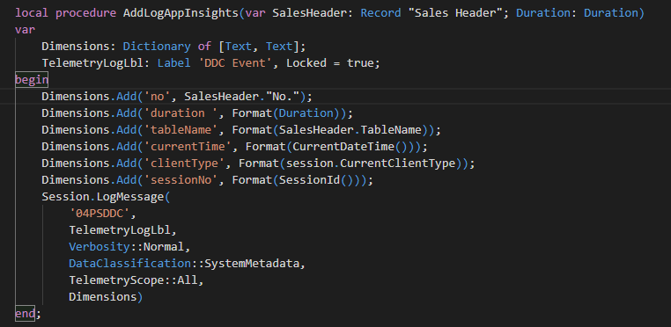
Zelf Telemetry maken
Telemetry it is as easy as 123

Slide 13
Wat komt er binnen?
Telemetry it is as easy as 123
voorbeelden in App Insights
Notes:
Queries -> LRQ No. Series, Own Event Vertellen welke waarden er allemaal binnen komen Aantal waarden dubbel ivm deprecatedKeys

Slide 14

Vragen
Telemetry it is as easy as 123

Slide 15
Kusto Qeury language (KQL)
Telemetry it is as easy as 123
Is een read only qeury language
Traces en Pageviews
KQL quick reference | Microsoft Docs
SQL to Kusto query translation - Azure Data Explorer | Microsoft Docs
Telemetry Event IDs in Application Insights - Business Central | Microsoft Docs
Notes:
Kusto Query language Leuk weetje: Kusto was de originele codenaam van Application Insights en genoemd naar Jacques Cousteau, de franse onderzee ontdekker

Slide 16
Kusto Qeury language (KQL)
Telemetry it is as easy as 123
Voorbeeld:
traces | where customDimensions.eventId == 'RT0005’ //signal of Long Running Qeuries | where timestamp > ago(2d) //set this otherwise is takes very long time | where customDimensions.alObjectId > 0 // filter out internal server calls | where customDimensions.environmentType == 'Production’ | extend sqlStatement = tostring( customDimensions.sqlStatement ) | extend environmentName = cloud_RoleInstance , environmentType = tostring( customDimensions.environmentType ) , alObjectName = tostring( customDimensions.alObjectName ) ,
alObjectType = tostring( customDimensions.alObjectType ) ,
executionTimeInMS = toreal(totimespan(customDimensions.executionTime))/10000 //the datatype for executionTime is timespan ,
extensionVersion = tostring( customDimensions.extensionVersion ) , numberOfJoins = countof(sqlStatement, "JOIN") ,
numberOfOuterApplys = countof(sqlStatement, "OUTER APPLY") , alStackTrace = tostring( customDimensions.alStackTrace ) | summarize totalexecutionTimeInSec = sum(executionTimeInMS)/1000, countOfExecutions = count() by extensionVersion,alObjectName, sqlStatement, numberOfJoins,
numberOfOuterApplys,
alStackTrace
| project extensionVersion, alObjectName, sqlStatement, countOfExecutions, totalexecutionTimeInSec, numberOfJoins, numberOfOuterApplys, alStackTrace
| order by countOfExecutions desc
Notes:
Kusto Query language Where = voor filtering Extend = extra kolommen toevoegen
Sumarize = waarden optellen project = kolommen weergeven Order = sortering welke kolom

Slide 17
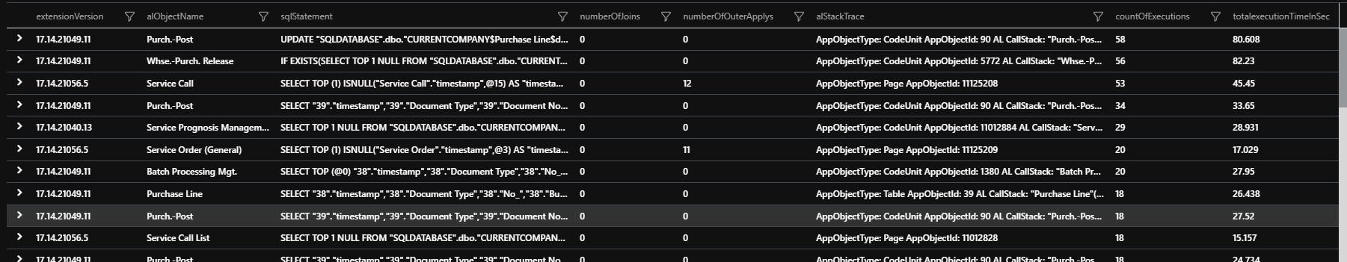
Kusto Qeury language (KQL)
Telemetry it is as easy as 123
Voorbeeld:

Slide 18
Long Running Queries
Telemetry it is as easy as 123
Denk aan de standaard threshold van 750ms in SaaS
Kijk daarnaast ook naar:
In SQLStatment -> Achter de WHERE is daar een bijpassende sleutel?
WITH UPDLOCK -> tabel word gelokt gelezen
Denk aan Findset(false) -> bij een insert locked hij de tabel!
SELECT SUM("SUM$Hours") FROM "SQLDATABASE".dbo."CURRENTCOMPANY$Budget Line$d809cdc6-44fd-485c-b9ed-2841276bbf32$VSIFT$Key9" WITH(READUNCOMMITTED,NOEXPAND) WHERE ("Project No_"=@0 AND "Cost Type"=@1 AND ("Extension Contract Status"=@2 OR "Extension Contract Status"=@3 OR "Extension Contract Status"=@4)) OPTION(OPTIMIZE FOR UNKNOWN)
SELECT COUNT(*) FROM "SQLDATABASE".dbo."CURRENTCOMPANY$Hours Line Last Used Object$d809cdc6-44fd-485c-b9ed-2841276bbf32" "11126055" WITH(UPDLOCK) WHERE ("Company"=@0 AND "Employee No_"=@1 AND "Type"=@2) OPTION(OPTIMIZE FOR UNKNOWN)
Notes:
Threshold on-premise in NST kun je aanpassen LRQ kan komen door een lange querie maar ook door een veroorzaker

Slide 19
Long Running Queries
Telemetry it is as easy as 123
Long Running Queries -> RT005 -> is slachtoffer
RT0012 -> is de veroorzaker
RT0013 -> Database snapshot
// this query shows how to join lock timeout events (RT0012) with the lock snapshot events (RT0013) let Timeouts = traces | where timestamp > ago(5d) // adjust to your needs | where customDimensions.eventId == 'RT0012’ | extend snapshotId = tostring( customDimensions.snapshotId ) | project snapshotId,
message,
timestamp,
alObjectIdLockTimeout = customDimensions.alObjectId, alStackTraceLockTimeout = customDimensions.alStackTrace,
sqlTableLockTimeout = customDimensions.sqlTableName;
Timeouts
| join (traces
| where customDimensions.eventId == 'RT0013’
| extend snapshotId = tostring( customDimensions.snapshotId )
| project snapshotId ,
alObjectIdHoldingLock = customDimensions.alObjectId,
alStackTraceHoldingLock = customDimensions.alStackTrace,
sqlTableLocked = customDimensions.sqlTableName )
on $left.snapshotId == $right.snapshotId
| order by snapshotId
| project-away snapshotId, snapshotId1

Slide 20
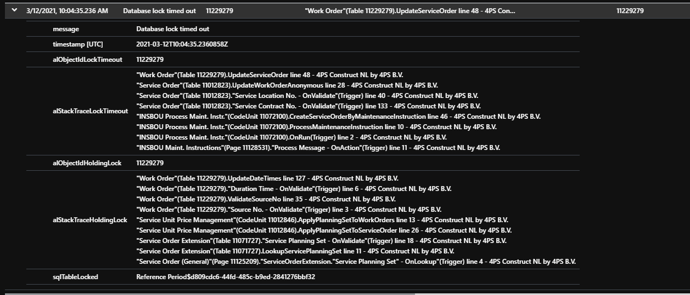
Long Running Queries
Telemetry it is as easy as 123
Notes:
alStackTraceLockTimeOut => degene die de time out veroorzaakt alStackTraceHoldingLock => degene die de lock vasthoud. Hier zit het probleem in. Maar alle twee de StackTrace goed bekijken.

Slide 21
Page views
Telemetry it is as easy as 123
Naast traces ook pageviews
Wat word er gemeten?
Performance buckets
Factbox uitgeklapt
Fasttabs uitgeklapt
Designerlevel -> Personalisatie, Confguratie, Development, Inspector, Geen
Resolutiescherm
User Flows (en nog veel meer)
Notes:
Word je functionaliteit wel gebruikt en performt het wel? Qeury PageViews laten zien
User Flows laten zien. Andere kort benoemen

Slide 22
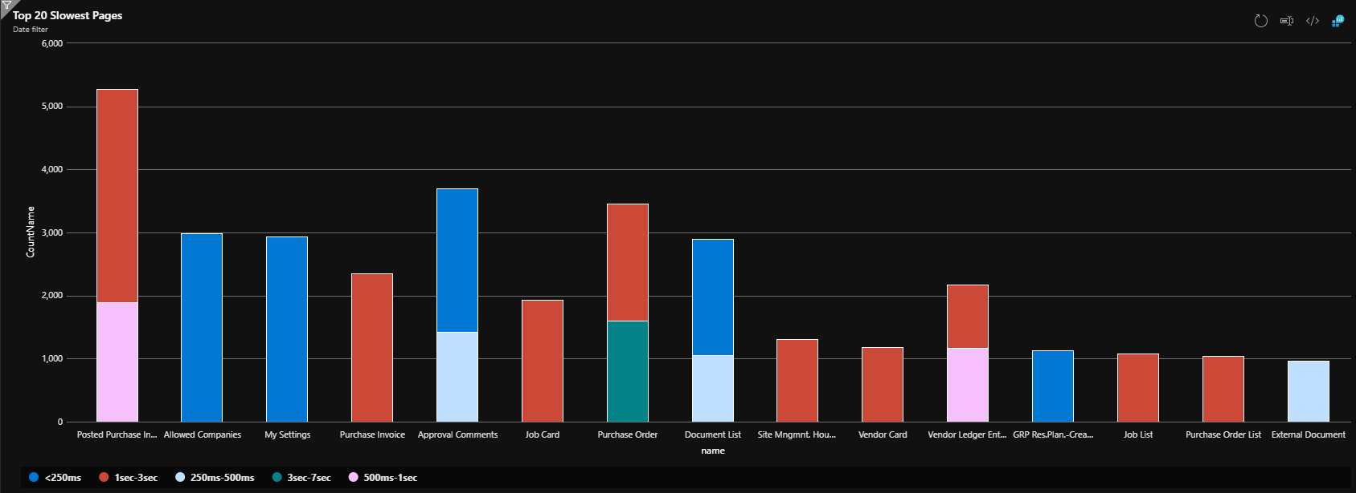
Kusto Qeury language (KQL)
Telemetry it is as easy as 123
Voorbeeld:
pageViews
| where customDimensions.alObjectId <> -1
| where customDimensions.environmentType == 'Prod’
| where timestamp > ago(2d) //set this otherwise is takes very long time
| order by performanceBucket desc
| summarize CountName=count() by name, performanceBucket, tostring(customDimensions.alObjectId)
| top 20 by CountName
| render columnchart
Notes:
Top = de top 10 of 20 laten zien
Render = waarden in een grafiek tonen

Slide 23
Welke tools?
Telemetry it is as easy as 123
Analyze in Azure Portal met Logs of dashboard
Kusto.explorer
Azure Data Studio
Power BI
Notes:
Ervaring delen hoe gebruiken wij het

Slide 24
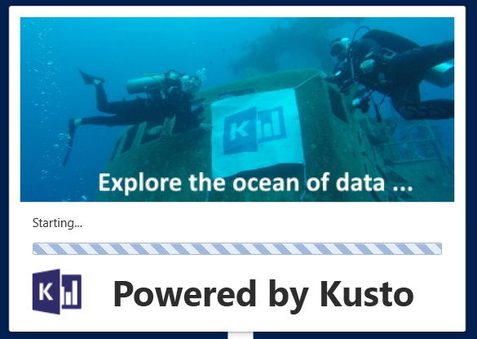
Kusto.Explorer
Telemetry it is as easy as 123
Programma op de desktop
Dimensies worden plat weergegeven (nadeel)
Makkelijk voor even snel uitproberen Connection string: https://ade.applicationinsights.io/subscriptions/{SubscriptionID}/resourcegroups/{ResourceGroup}/providers/microsoft.insights/components/{AppInsightsName}
Notes:
Plaatje verwijst ook naar Jacques Cousteau
Live voorbeeld

Slide 25
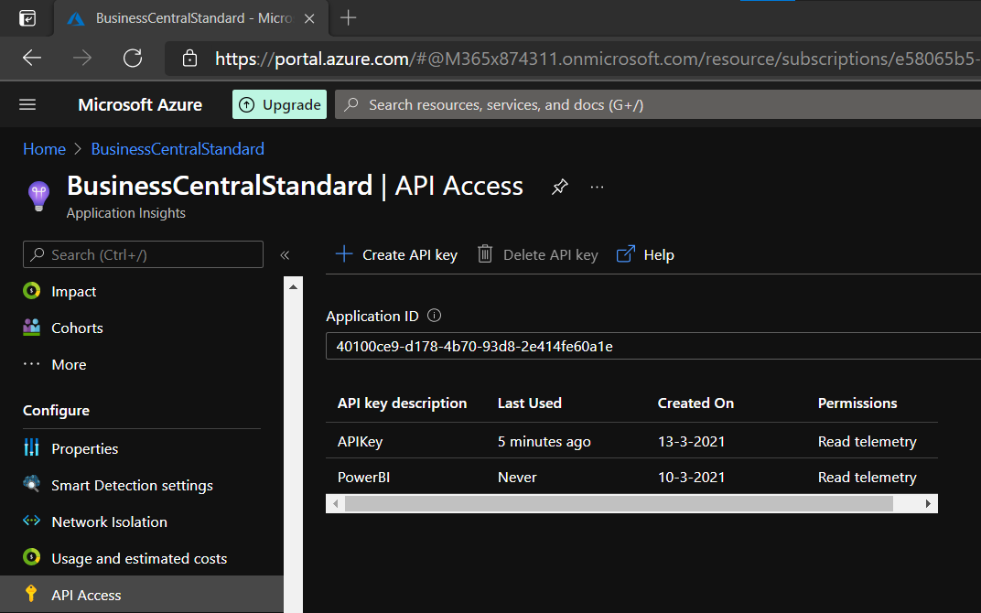
Azure data studio
Telemetry it is as easy as 123
Azure Portal Queries per keer afvoeren.
Jupiter Notebook -> Python en KQL
Handleiding installatie -> BCTech/samples/AppInsights/TroubleShootingGuides at master · microsoft/BCTech (github.com)
Notes:
Denk aan API access in Application insights Live voorbeeld

Slide 26
Power BI
Telemetry it is as easy as 123
Werkt alleen met AAD connectie (dus in zelfde domein) en power BI desktop
Qeury maken in Azure Portal -> exporteren als PowerBI Qeury
Export als M qeury import in Power BI.
Notes:
Demo laten zien. Start -> Gegevens ophalen -> Lege qeury
4PS Azure portal export to PowerBI

Slide 27
Dashboard Azure Portal
Telemetry it is as easy as 123
Live voorbeeld
Sjabloon: Bertverbeek4PS/AppInsights (github.com)
Notes:
Live voorbeeld laten zien

Slide 28
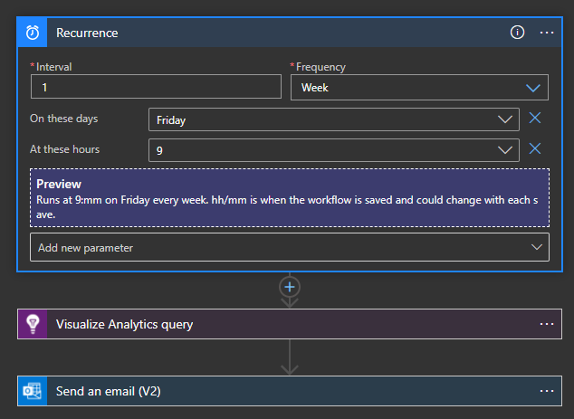
Mails instellen
Telemetry it is as easy as 123
Periodiek instellen van signalen -> vooral Long Running Queries.
Via “Logic App”
Notes:
Logic app laten zien. Hoe aangemaakt.

Slide 29
Alerts
Telemetry it is as easy as 123
Kritieke signalen? -> Alerts
Geef KQL query in
Stel alert logic in
Waar moet hij aan voldoen.
Maak actie groep aan
Notificatie via mail / sms / voice
Kosten van alert worden direct zichtbaar
Notes:
Live demo Denk aan Time range -> 30 dagen zetten
Mail laten zien die is ontvangen.

Slide 30
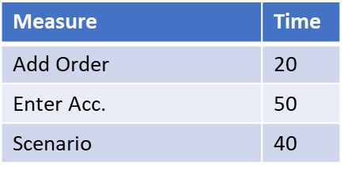
Performance Toolkit
Telemetry it is as easy as 123
Performance Toolkit is vooraf
Schrijf zelf test codeunits
Iedere codeunit kan meerdere scenario’s bevatten
Individuele acties meten
Dit is inclusief “User Waits”!
Gebruik maken van “User Waits” om echt gebruik te simuleren
Ook gehele CodeUnit.Run() word gemeten zonder “User Waits”
Opstarten via PowerShell
0
10
30
50
60
100
Scenario 1
Start ‘Add Order’
End ‘Add Order’
UserWait
Start ‘Enter Acc.’
UserWait
End ‘Enter Acc.’
Notes:
Voorbeeld laten zien van SalesInvoice.Codeunit.al Ook BCPT Suite laten zien in Test omgeving
Ook telemetry laten zien

Slide 31
Helpfull links
Telemetry it is as easy as 123
Using a remote D365BC notebook in Azure Data Studio | LinkedIn
Power BI performance report on #MSDyn365BC telemetry in Azure Application Insights | LinkedIn
Learning Dynamics 365 Business Central telemetry in a week | LinkedIn
Performance Overview - Business Central | Microsoft Docs

Slide 32
Vragen
Telemetry it is as easy as 123
Notes:
Live demo

Slide 33
Bedankt voor uw aandacht!
06-52857241
bverbeek@4ps.nl
Keplerlaan 4, Ede

